Slide 1
HL7 Hong Kong FHIR Connectathon
Introduction
22 Apr 2023

Slide 2
Data Shared on eHRSS

Slide 3
Roadmap of FHIR at EHRSS
Upgrade existing HCP sharing interface to FHIR
Enable two-way sharing on Public-private program to minimize duplicated input
Adopt FHIR International Patient Summary (IPS) for cross-broader sharing

Slide 4
Current HL7 version used at eHRSS
HK eHealth DB
HL7 v2.5
HL7 CDA
HL7 v2.5
HL7 CDA
DICOM

Slide 5
HK eHealth DB
DICOM

Slide 6
What is “Connectathon”?
Source: https://healthcaresecprivacy.blogspot.com/2013/11/what-is-connectathon.html

Slide 7
The “first” FHIR Connectathon for HK
To be arranged on Summer 2023
Scope
Data mapping of eHRSS data sharable scope, data compliance level 3 discussion (HKCTT vs international standards)
Extension for HK localization for eHRSS
Encourage participant to generate the FHIR samples

Slide 8
Example: Allergy
Healthcare provider share Allergy record to eHRSS using FHIR
Reference (Data requirement, code value, sample data)
https://www.ehealth.gov.hk/filemanager/content/pdf/en/ehris/annex/appendix-a-vi-ehr-allergy.pdf
Sample data
Participant create and submit the FHIR samples
Use FHIR validator (link) to check the submitted FHIR samples

Slide 9
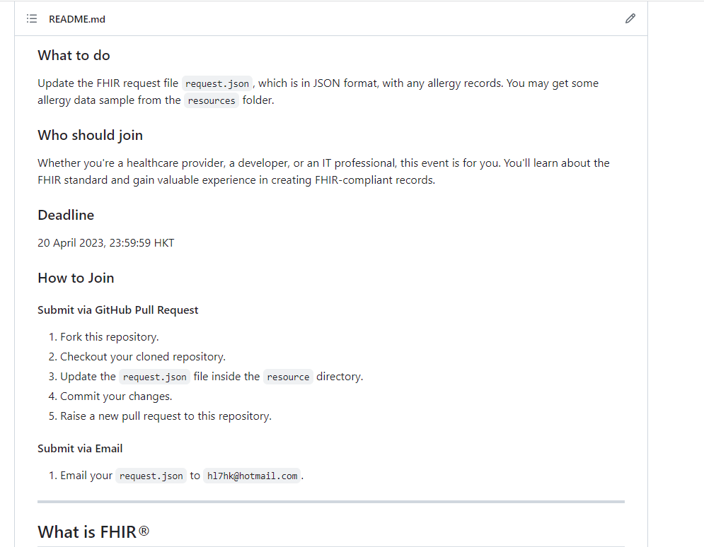
Samples will collect at GitHub page

Slide 10
Expectation
Promote HL7 FHIR to HK eHealth community
Define HK EHRSS profile for data sharing
Collect IPS implementation comment and feedback to Global Digital Health Partnership (GDHP) Interoperability Work Stream

Slide 11
Closing Remark

Slide 12
Reference Slides

Slide 13
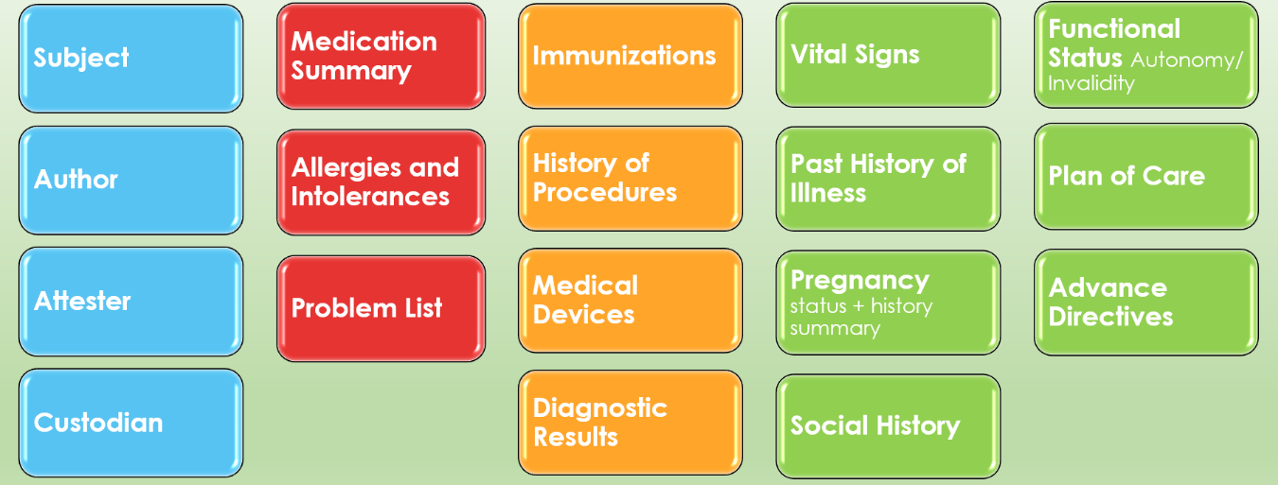
International Patient Summary
International Patient Summary (IPS FHIR R4)
An International Patient Summary (IPS) document is an electronic health record extract containing essential healthcare information about a subject of care. As specified in EN 17269 and ISO/DIS 27269, it is designed for supporting the use case scenario for ‘unplanned, cross border care’, but it is not limited to it. It is intended to be international, i.e., to provide generic solutions for global application beyond a particular region or country.
The IPS dataset is minimal and non-exhaustive; specialty-agnostic and condition-independent; but still clinically relevant.
Header & Required
Recommended & Optional

Slide 14
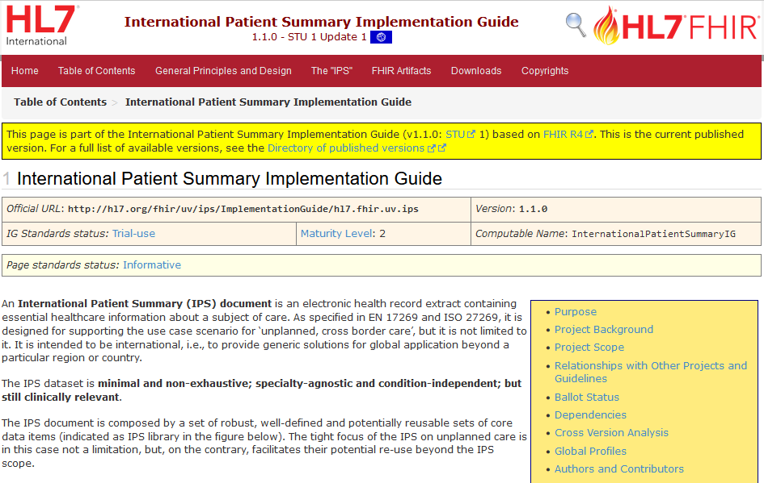
HL7 FHIR IPS Implementation Guide
Standard for Trial Use

Slide 15
IPS Structure
Bundle
Composition (1)
Patient (1)
Practioner (*)
Organization (*)
AllergyIntolerance (*)
MedicationRequest(*)
MedicationStatement(*)
Condition (*)
Immunization (*)
Observation (*)
Other Resources (*)
Composition
Elements that describe the document (id, language, text, etc.)
Subject of the IPS
Author of the IPS
Clinical Services of IPS
Sections of the IPS
Narrative Text
Resource References

