Slide 1
Smart on FHIR enables Innovative Solutions
APEHC
April 20, 2023 Hong Kong STP
Grahame Grieve

Slide 2
Origin of FHIR: the state of Healthcare
Health care has broken processes
Other industries are being transformed
IT enables process transformation
“Patient Centered Ecosystem” is happening very slowly in healthcare
IT standards to integrate B2B and C2B do not exist
IT is not properly implemented
There are many other blockers (culture, business process, liability, regulation)
Innovation is hard work – network problem

Slide 3
FHIR: The web, for Healthcare
Open Community
Open Standard
Make it easier to exchange healthcare information
Open Participation - uses web infrastructure (social media)
Lead by HL7 - deeply connected to world wide health community
Describes how to exchange healthcare information
Public Domain (http://hl7.org/fhir)
A web API - web standards where possible
Continuity with existing healthcare standards

Slide 4
FHIR: Healthcare API
“Application Programming Interface”: A list of operations that other programs can use
Web APIs: operations offered using web technologies, work remotely across the internet (or locally)
FHIR offers healthcare services:
What are the patient details?
Fetch Laboratory reports for a patient
Prescribe a medication for the patient
Suggest a treatment option for a patient based on diagnostic reports
etc

Slide 5
Freely available
Known address: http://hl7.org/fhir
License: Creative Commons Public Domain (CC0):
“No Rights Reserved”
You can copy, modify, distribute and perform the work, even for commercial purposes, all without asking permission
The most open of open licenses
Anyone can do anything with the content
There can be no disputes about ownership of rights to do anything with the FHIR content - HL7 waived its rights
HL7 Does protect the trademark / logo
Notes:
Was a bigger deal before HL7 decided to open up all IP
full legal text towards bottom of FHIR home page

Slide 6
About HL7
HL7 = Health Level 7
7 = Obscure reference to obsolete network model: application exchange
HL7 publishes Health care data exchange standards
V2 : healthcare messaging (“HL7”) – widely adopted
V3 : healthcare exchange modelling framework – not much adopted
CDA : Clinical Document Framework (MyHR, others)
FHIR : API for Healthcare data exchange, based on current technology
CCOW, CQL, Arden Syntax, others

Slide 7
Building on the Idea
A small passionate community rapidly grew around the idea
Built specification, tools, demonstrations, web presence
Took some exemplars into production
Over time, community matured, governance stabilised & reconciled
Selected by Argonaut (US EHR vendors) + Apple for C2B use
various national uses (e.g. English NHS)
More pilots, more success around the world
Rapid growth in community – meetings, social media,

Slide 8
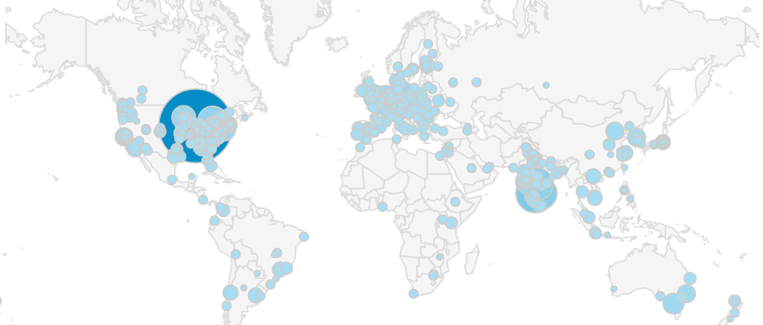

Slide 9
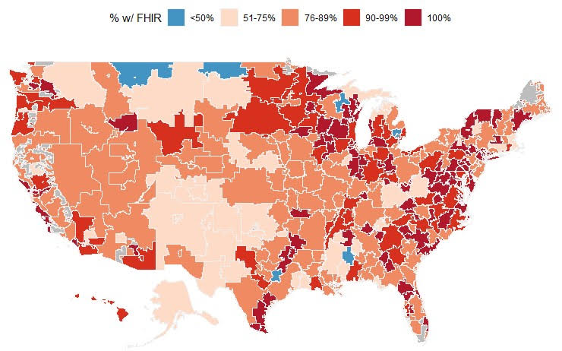

Slide 10
Why SMART?
Major Problem: Clinical record systems (LIS / EHR) have massive amounts of data
All sorts of interesting clinical / business rules could help
Vendors can’t do everything
So:
Provide a General Purpose API that allows access to EHR data and services
With Integrated security
And a way to launch application in a child window

Slide 11
SMART: Substitutable Medical Apps, Reusable Technology
User (Clinician / Patient / Family)
FHIR – Access Clinical Data & services (IPS/CDI)
OAuth – Identify User & Get permission
Clinical Context – Integrate workflow and presentation
Smart App
(Mobile / Desktop)
Clinical Record
(GP /Institution / National)

Slide 12
SMART: Substitutable Medical Apps, Reusable Technology
User (Clinician / Patient / Family)
FHIR – Access Clinical Data & services (IPS/CDI)
OAuth – Identify User & Get permission
Clinical Context – Integrate workflow and presentation
AS
RS
Smart App
(Mobile / Desktop)
Clinical Record
(GP /Institution / National)

Slide 13
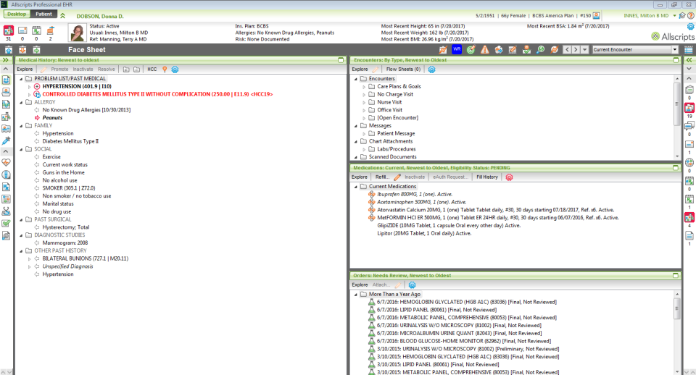
What do you want to put here?
Your own application

Slide 14
Extensible Clinical Record Systems
Launch apps that can access patient record
Add a way to inject ‘suggestions’ into the application
E.g. what things could/should you do for this patient?
Write your own surveillance/management tools
Examples in production:
Custom advanced dosing regimes (‘DoseMe’)
Risk calculators (by many clinical risk ratings)
Case Registration applications
Apple Health (/Personal Health access)

Slide 15
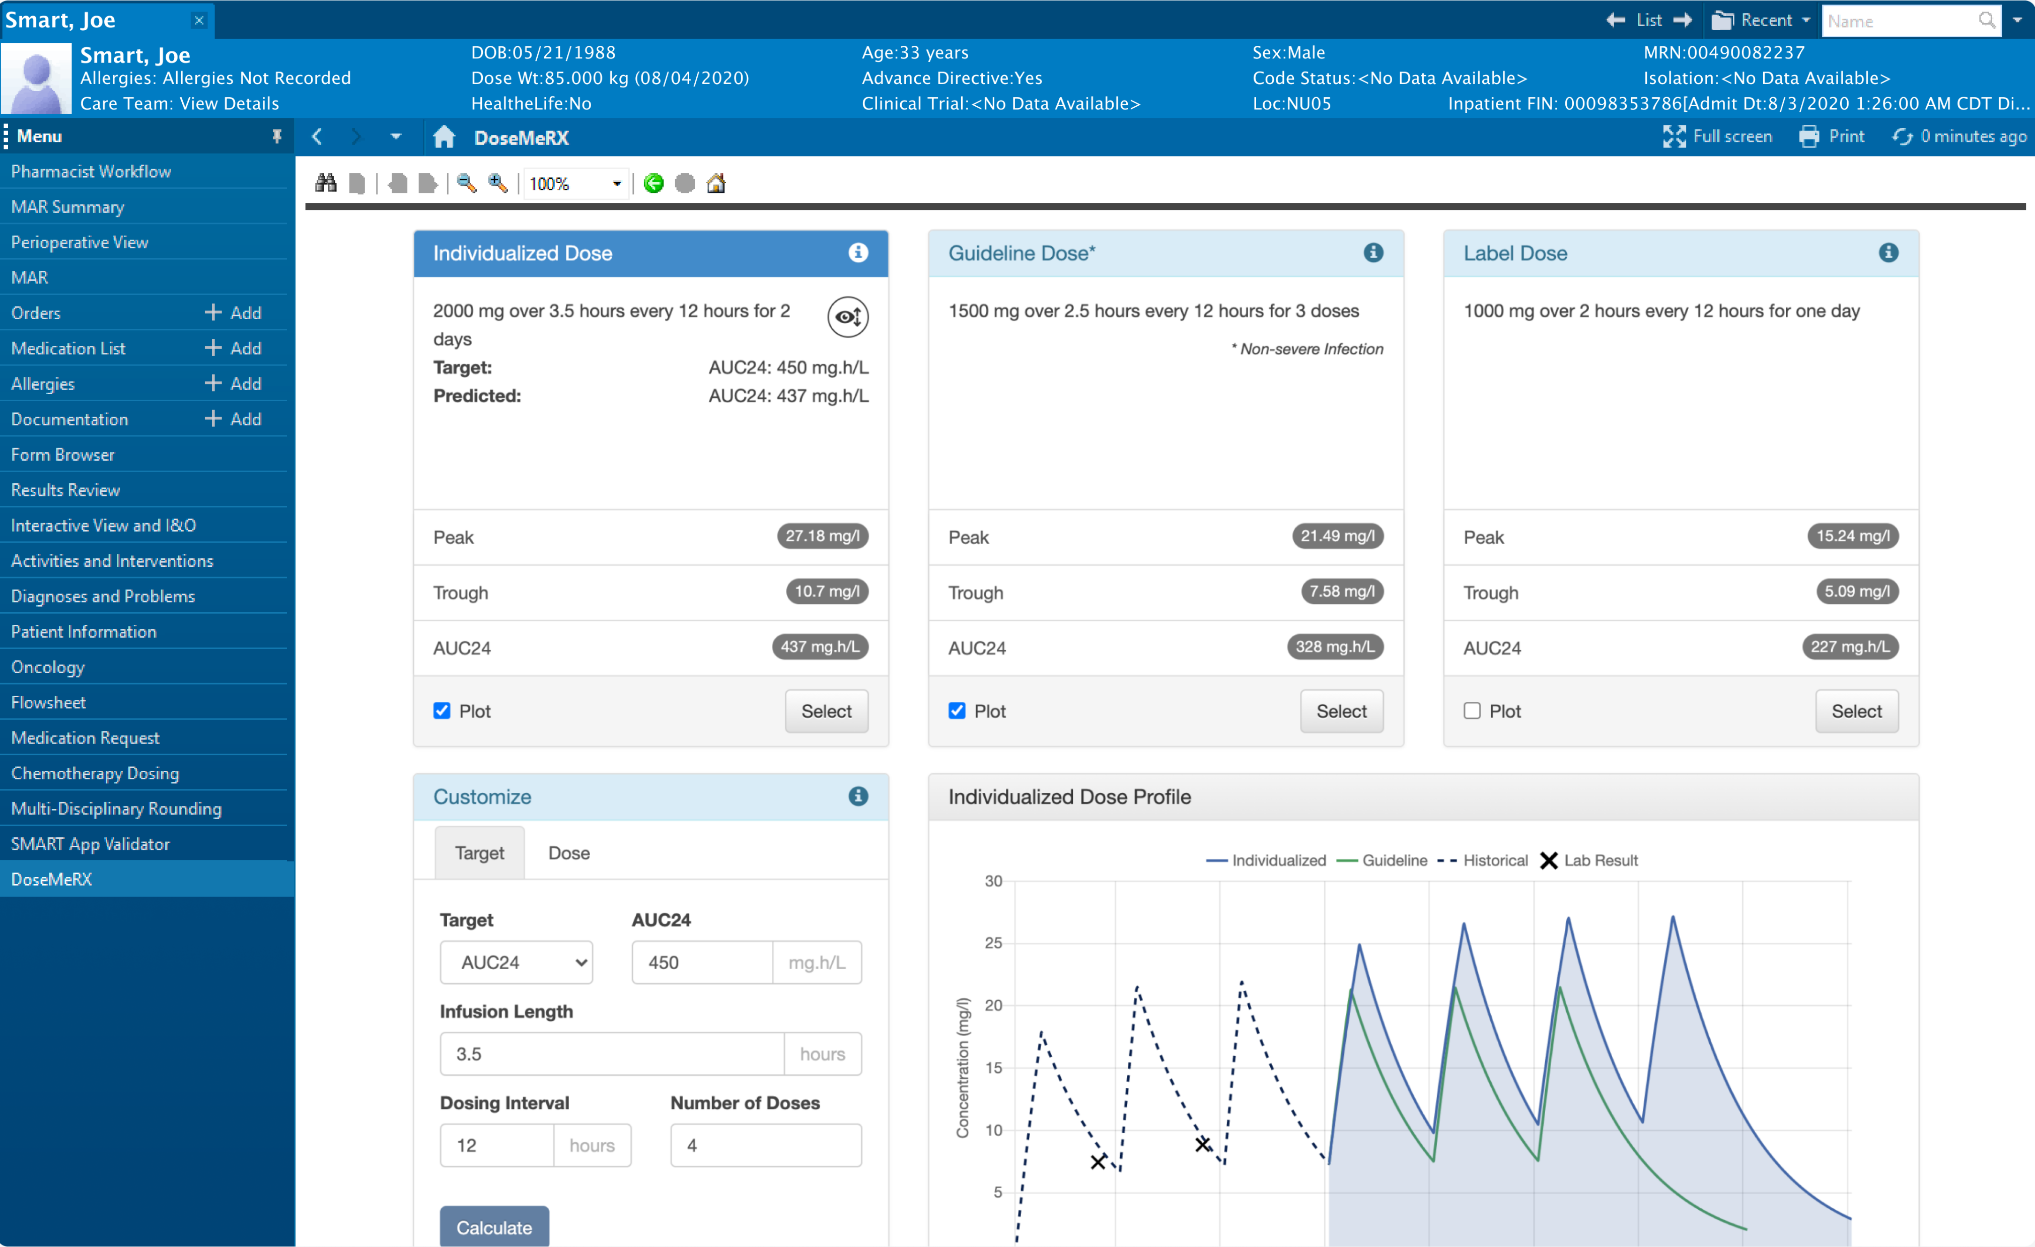

Slide 16
Case Study: Personal Health Records
2010: the year of personal health records
Each repository / clinical service cost $$$:
Marketing, Sales
Contact Negotiations / Legal Fees
Development / testing / deployment
Maintenance, trouble shooting
TCO: ~$150k (US)

Slide 17
Case Study: Argonaut
Government instigated project involving US EHR vendors
Vendors ran their own project
Goal: define a public API for patients to get their own data
Secondary goal: use the same API for application extensibility
Outcome: an industry specification for letting the patient get their healthcare summary –
Medications, Allergies
Labs, Vital Signs
Documents (/ Clinical Notes)
All done securely via SMART on FHIR

Slide 18
Case Study: Apple Healthkit
Apple Healthkit uses Argonaut specification (US Only)
Hospitals can register with Apple for free
Hospitals get software with the capability for free
Register with Apple for free
Have to pass the Apple testing process (some weeks work)
Have to maintain patient portal accounts
Reduction in cost for PHR: >90% - it’s a commodity

Slide 19
Smart Launch Sequence #1: Embedded
EHR is configured to use a Smart Application (web/mobile)
Creates a contained browser window. Sends browser to Application with a ‘Launch Context’
Application loads, and then sends browser to auth endpoint
User discusses the request for access with the Auth server
Auth server redirects to app with “auth” token
App converts token to Access token
App makes requests of EHR using Access token
Until user/EHR closes it

Slide 20
Smart Launch Sequence #1: Stand Alone
Application wishes to connect to EHR (Mobile/Web/Desktop/Server)
Creates a browser (thing). Sends browser to auth endpoint
User discusses the request for access with the Auth server
Auth server redirects to Application (server) with “auth” token
Application converts token to Access token
Application makes requests of EHR using Access token
Until EHR rejects the access token (go back to start)

Slide 21
Smart Launch Application Registration
EHR decides which authorizations to approve
Subject to organizational policy and vendor decision making
Most EHRs require applications to be registered in advance
Not necessary technically, but enforce policy and business practices
Enforce business agreements
Check security & useability
This becomes the focus point of contention around financialization

Slide 22
Smart Launch User Authentication
Smart App Launch doesn’t require the user to be identified
But can be, and almost always needs to be
Authorization outcome may include user details (app can ask for this)
Typically EHR must identify a user to decide what records are accessible
Client may also need to authenticate user for it’s own purposes
Unless it can match records from EHR details
Can set up SSO arrangements with EHR
EHR can delegate user authentication (e.g. national service) using 2nd stage OAuth (not Smart though)

Slide 23
Smart Launch: Scopes and Tokens
EHR & Apps inject tokens (unique identifiers) into the process
Track context for both parties (e.g. Launch Context)
There are various encryption and signing steps to secure the exchange
App requests a set of ‘scopes’. EHR grants a set of scopes
Each scope has scope/type.mode e.g. patient/Observation.rs
EHR can grant more or less access, depending on internal policies, institution policies, user rights etc
Scopes are a language for the interaction with the user – what is the app proposing to do?

Slide 24
Why use SMART on FHIR?
All the advantages of FHIR, e.g.:
Free Open Source Specification
Leverage Web technology / security / community
Active & helpful FHIR community
Can use other standards
V2 – designed for back-office exchange
CDA / XDS – designed for historical record collection
Can do it your own way (down with standards)

Slide 25
Standards Cost More!
Standards increase up front costs
Encountering requirements you don’t (yet) have
More development than a custom agreement
Standards decrease follow up costs
More re-use of work in the future
Less re-work (safer! Lower Risk!)
Easier (cheaper) to find staff & maintain institutional memory
More likely to be compliant with regulation
Can’t achieve data lock-in by dead-end-thinking

Slide 26
Software Process
Most clinical systems are extremely configurable
In fact: frameworks for systems, not systems
Extensive implementation project to build a custom configuration
‘ERP style software’ e.g. SAP – organization spends significant portion of budget managing it’s own special business rules
‘SaaS style software’ – much reduced customization saves an organization real budget
Eating the market from small → large
Based on ‘Deep Interoperability’

Slide 27
Shallow vs Deep Interoperability
Integration points on the perimeter:
Integration Points part of the system:

Slide 28
Hacking FHIR: Is it secure?
Alissa Knight is a professional hacker who was paid to hack production APIs and publish her results
EHRs were very secure. Other Apps: very insecure
This is scary! Why use FHIR?
Because you will be hacked – so why not be part of the solution?

Slide 29
Lessons Learned - Alissa
Public notification of a security breach will generate real controversy
Much of it misinformed & some of it malicious
There will be real political costs
Handling it properly pays off – be prepared
Ecosystems based on open standards are more resilient
Economics justifies white hat hacking

Slide 30
Lessons Learned
Implementers are all over the place
Some implementers are very good indeed
Some implementers are not!
Culture matters. Leadership matters
Solutions vary widely between jurisdictions
Responding to different risks, driven by different purchasing choices
Implementers / adopters that are suspicious of new technologies (cloud) are not suspicious enough of their existing practices

Slide 31
FHIR is not a silver bullet
FHIR is a nice technology
The FHIR specification only captures what everyone will agree to
“Platform” on which to build agreements
People still have to agree about everything else
Countries
Domains
Terminologies
Business Agreements / workflows
Framework & Motivation for introducing it

Slide 32
Building Community
Strategy / Architecture
Vendors and institutions need leadership to get over co-dependency issues
Education
Formal education (University)
Professional education
Learning / Testing Opportunities
“Connectathons” / Sandbox - opportunities for technical teams to test/learn with no risk
Local Specifications
Convert local issues to local specifications – regulation, language, accepted business practices

Slide 33
International Specifications
IPS: International Patient Summary
A set of agreed summary information about a patient
Common Content + Terminology rules
Portable as they travel (tourist/refugees/civil disruption)
Doesn’t specify how transfer happens – can be by Smart on FHIR
IPA: International Patient Access
A common way to access information for a patient in any country
Unbundle US Patient access from US Specific content rules
Because consumer technology is international in focus
Doesn’t make rules about content, just how to access information
Smart on FHIR for patients

Slide 34
Patient Oriented Systems
Clinical systems and their safety is often measured ‘compartmently’
Patient outcomes are hard to measure and hard to improve
Patients have little influence over the process or the outcomes
FHIR Project has the ultimate goal of improving patient outcomes

Slide 35
Empowering Patients
Make data accessible to Patients
Make data from patients accessible to system
Allowing patient to control data sharing between parties
Creating a single common patient record
But: Services not Data are empowering
FHIR offers the ability to extend services to the patient

Slide 36
Coordinated Care
Common Frustration of Patients:
Scheduling/Communication problems
Conflicting care plans / payment options
Conflicting system definitions of success
Must be resolved by the patient
FHIR enables Services for
distributed care plan
virtual clinical review
Virtual Institutions (internet hospitals, institutional boundaries)
Integrated Home Care (medication management)

Slide 37
FHIR & Disruption
FHIR disrupts healthcare (& healthcare IT):
Significantly reducing the cost of data exchange
Making it easy and natural to use the web
Encouraging the development of open community
Building a solid base to scale computation about healthcare
At the same time as wider web / open community transforms are happening.
Join a community….

